Slide 1
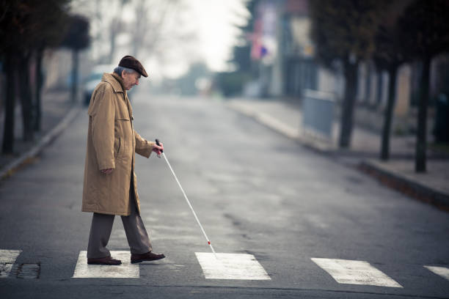
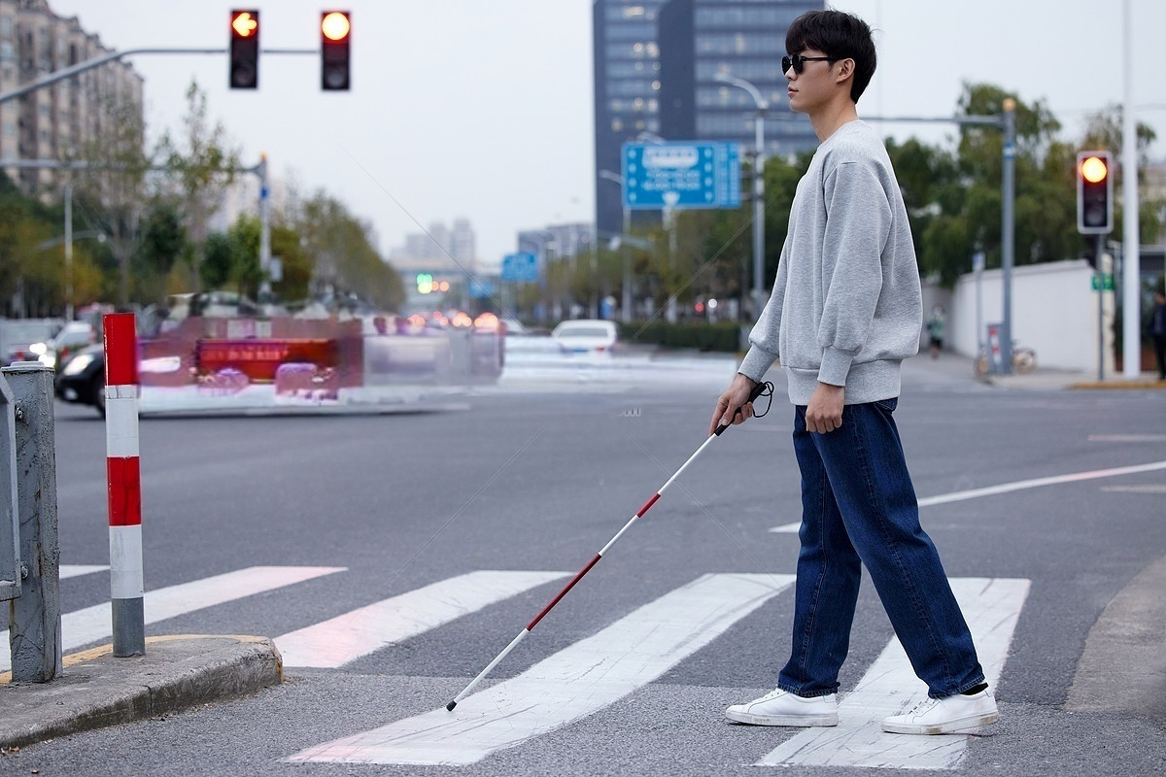


Slide 2
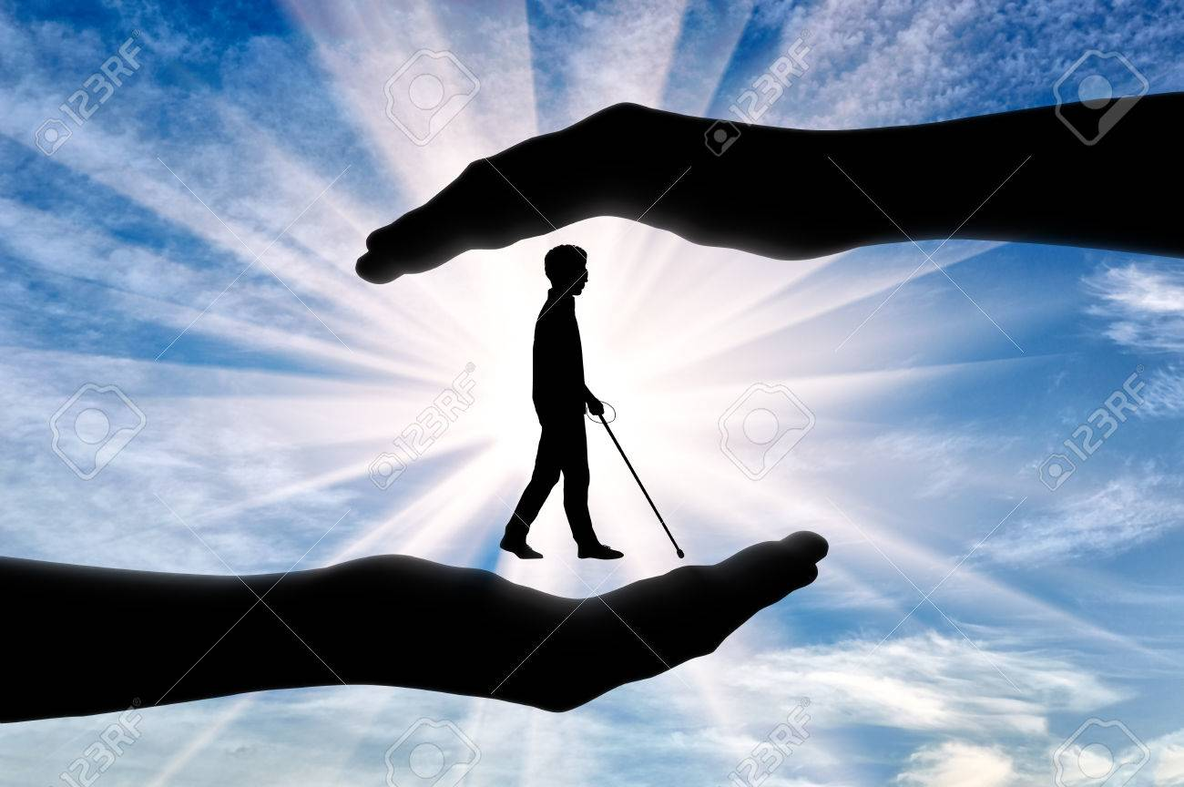
NEED of this Project:-
Globally, 2.2 billion people live with some form of vision impairment (World Health Organization).
India alone has 4.95 million blind individuals and 70 million with vision impairments, including 0.24 million blind children (National Institutes of Health).
In low-income countries, nearly 90% of people with disabilities lack access to necessary assistive technology (World Health Organization).
The lack of affordable solutions limits the independence and quality of life for individuals with visual impairments.

Slide 3
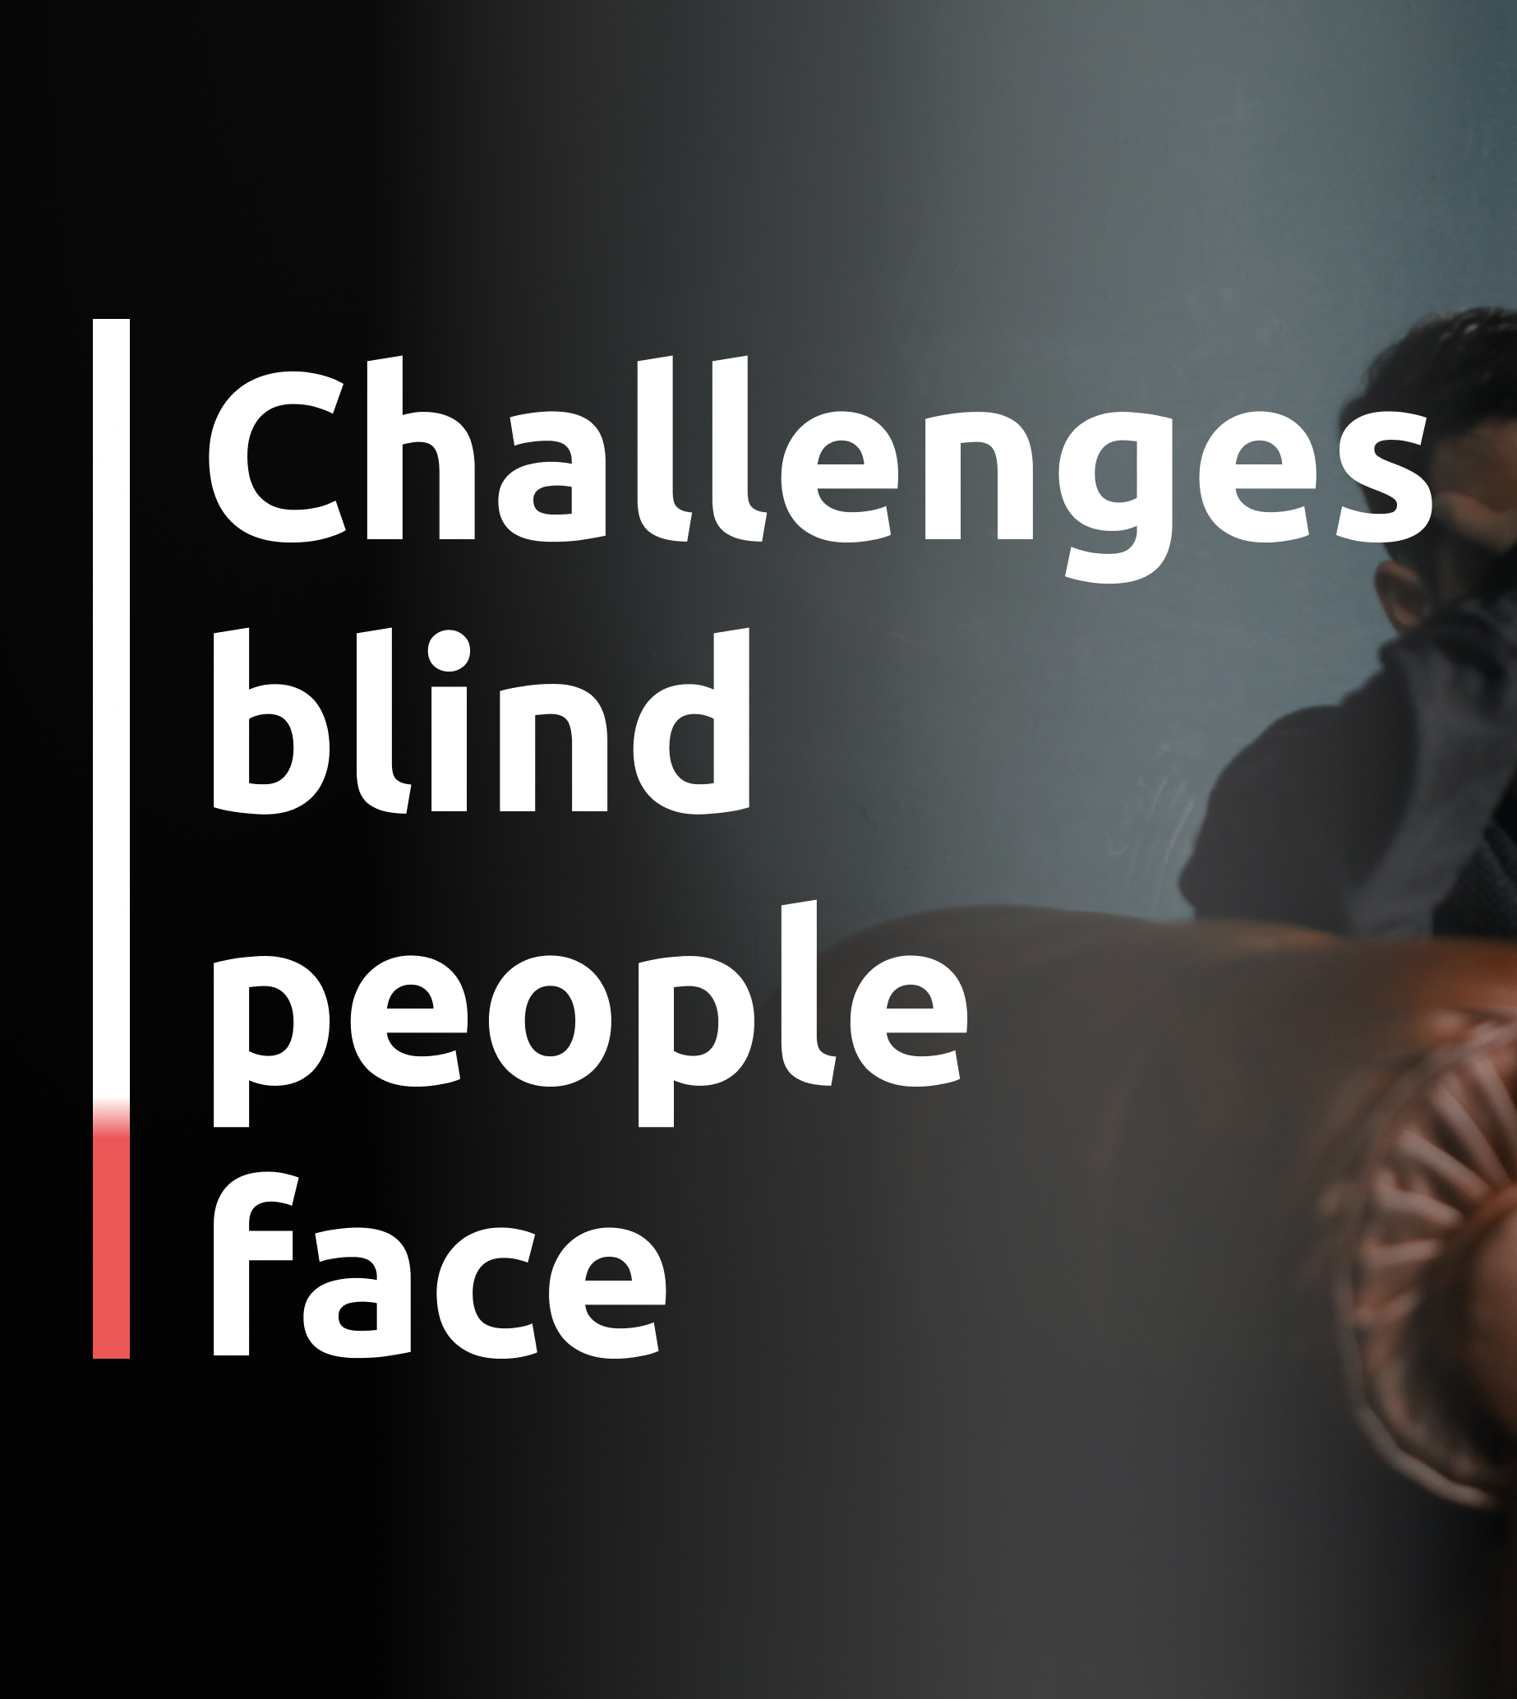
Limited Independence
Safety Concerns
Information Accessibility
Financial Constraints
Technology Barriers

Slide 4
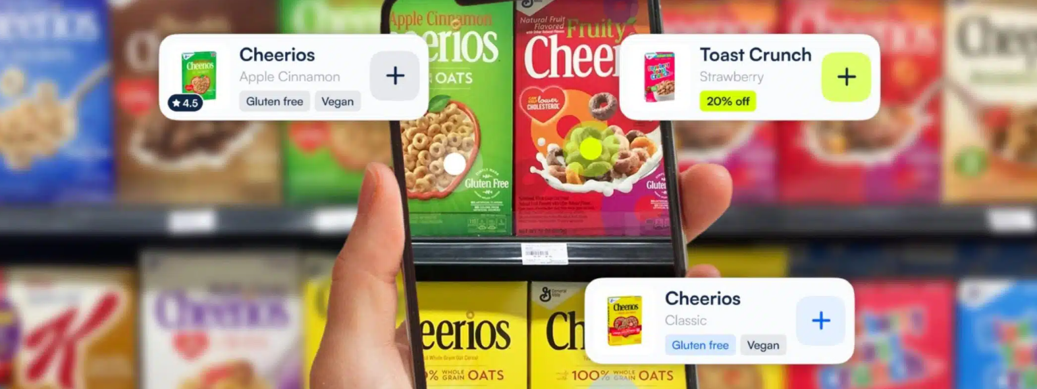
Key Features:-
Real-Time Product Detection
Brand Recognition
Voice Feedback System
Optimized for Cluttered Environments
Lightweight and Fast Inference
Future-Ready Features

Slide 5
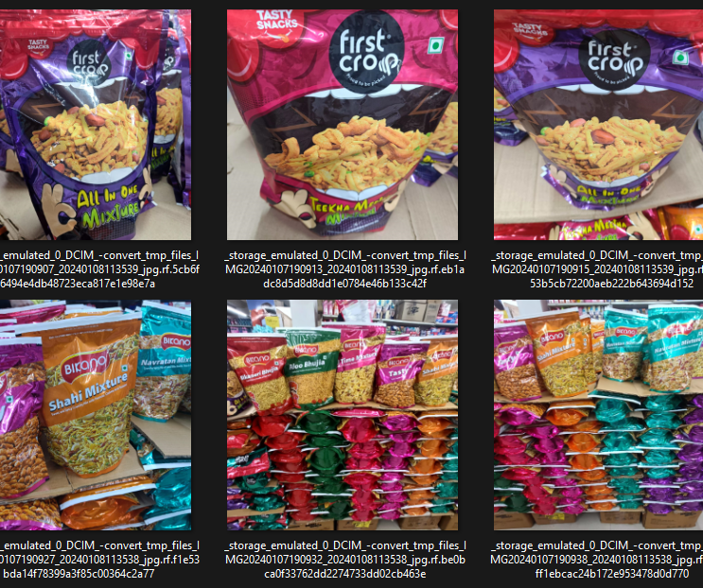
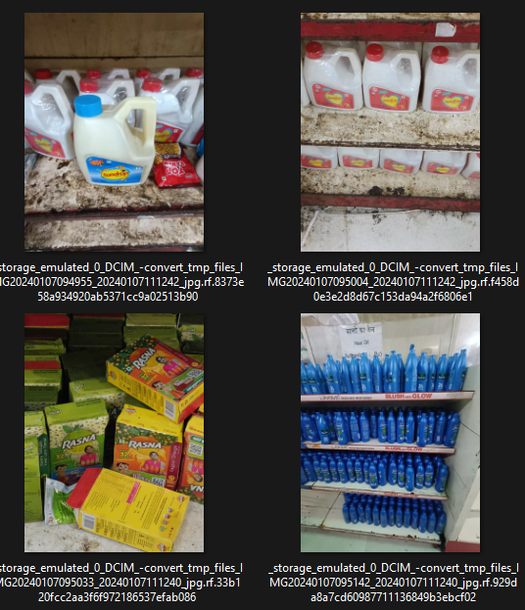
Grocery Data Set Samples:-

Slide 6
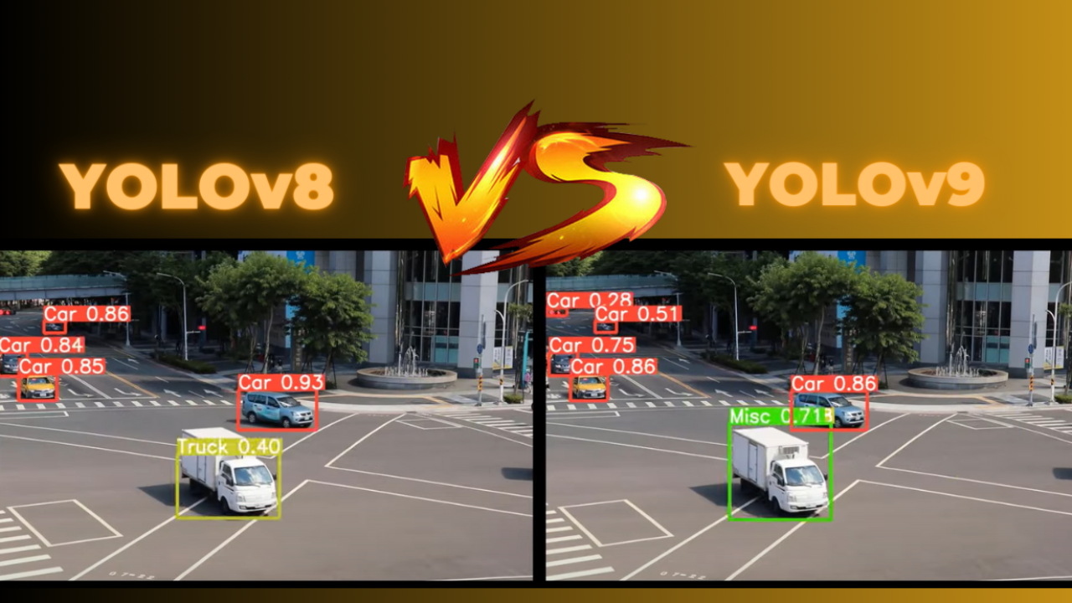

Slide 7

Which is Better: YOLOv8 or YOLOv9
YOLOv8
YOLOv9
Standard detection layers
Lightweight but moderate efficiency
Good accuracy, struggles small items
Adequate for large objects
Moderate FPS, real-time capable
Moderate inference time
Struggles with occluded items
Good in normal lighting
Needs optimization for mobile
Standard training time
Moderate resource consumption
Improved small object focus
More optimized and faster
Better accuracy, fine details
Enhanced for tiny details
Faster FPS, real-time optimized
Faster frame processing
Better handling of clutter
Handles varied lighting better
Optimized for mobile deployment
Requires longer training
More resource efficient

Slide 8
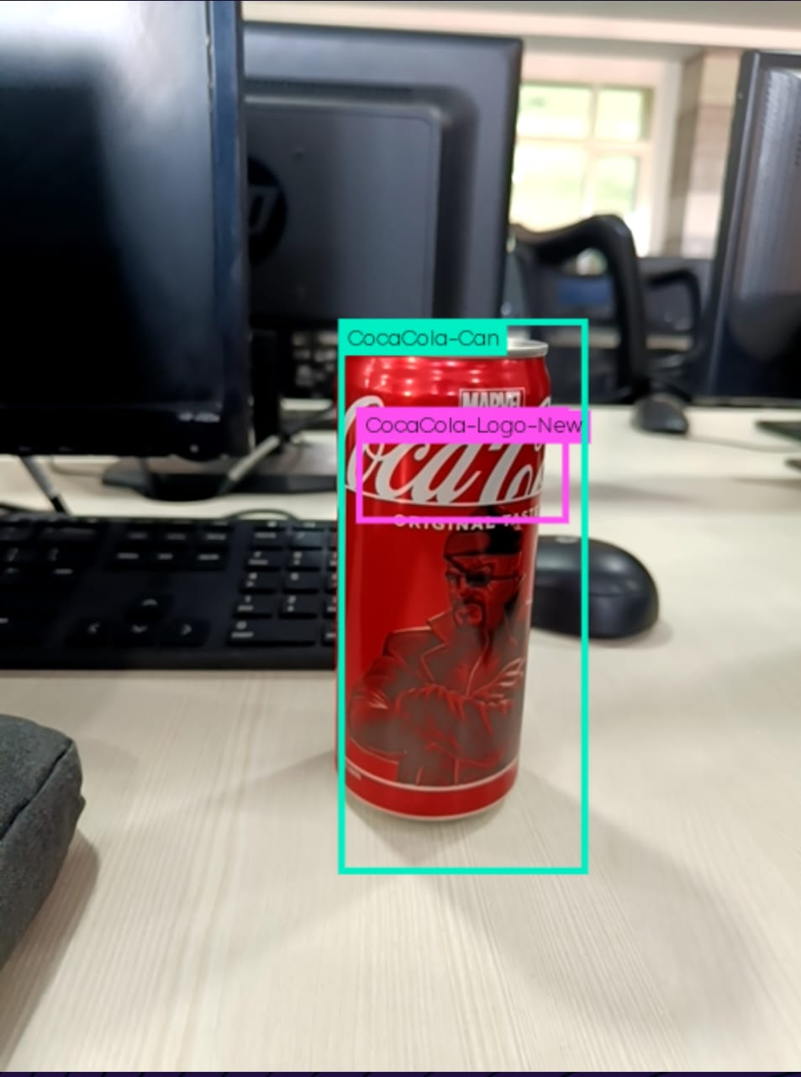
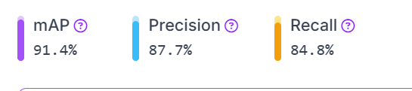
YOLOv8 scores:-

Slide 9

Tools To Be Used:-
TensorFlow
Ultralytics YOLOv8
YOLOv9 Repository
GPU (e.g., NVIDIA GPU)
Google Colab
AWS EC2
TensorBoard
OpenCV
PyTorch

Slide 10



Team Members:-
Vibhore Jain
Tanmay Arora
Swapnil Bhatnagar
Neeraj Gandhi

Slide 11

Thank you

